Slide 1
Chapter 5: Domain Modeling
Part 2 – DM Steps

Slide 2
Key Takeaway Points
Domain modeling is a conceptualization process to help the development team understand the application domain.
Five easy steps: collecting information about the application domain; brainstorming; classifying brainstorming results; visualizing the domain model using a UML class diagram; and performing inspection and review.
5-<number>

Slide 3
Domain Modeling in the Methodology Context
Business goals
& needs
Current situation
Use case-iteration allocation matrix
Accommodating
Requirements Change
Customer
feedback
Acquiring
Requirements
(Domain Modeling)
Iteration use cases
Domain Modeling
Preliminary requirements
Domain model
Domain model
Deriving Use Cases
from Requirements
Actor-System Interaction Modeling
Abstract & high level use cases, use case diagrams
Expanded use cases & UI design
Allocating Use Cases & Subsystems
to Iterations
Behavior Modeling &
Responsibility Assignment
Behavior models
Use case-iteration allocation matrix
Deriving Design Class
Diagram
Producing an Architecture Design
Design class diagram
Software architecture
Test Driven Development, Integration, & Deployment
(a) Planning Phase
(b) Iterative Phase – activities during each iteration
control flow
data flow
control flow & data flow
5-<number>

Slide 4

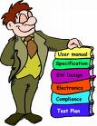


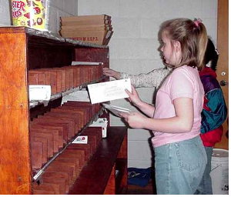

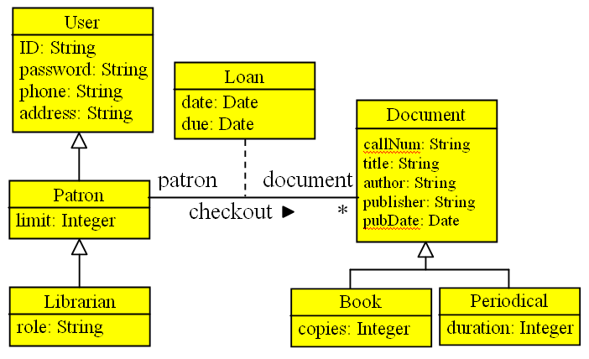
Domain Modeling Steps
2. Brainstorming
1.Collecting application
domain information
3. Classifying
brainstorming
result
4. Visualizing the
domain model
5. Reviewing the
domain model.
5-<number>

Slide 5
Steps for Domain Modeling
1) Collecting application domain information
  focus on the functional requirements
  also consider other requirements and documents
  also consider business descriptions
2) Brainstorming
  list important application domain concepts
  list their properties/attributes
  list their relationships
(to be continued)
5-<number>

Slide 6
Steps for Domain Modeling
3) Classifying the domain concepts into:
  classes
  attributes / attribute values
  relationships
    association, inheritance, aggregation
4) Visualizing the result using a UML class diagram
5-<number>

Slide 7
Brainstorming: Rules to Apply
The team members get together to identify & list domain specific
  nouns / noun phrases
  "X of Y" expressions (e.g., color of car)
  transitive verbs
  adjectives
  numeric
  possession expressions (has/have, possess, etc.)
  "constituents / part of" expressions
  containment / containing expressions
  "X is a Y" expressions
5-<number>

Slide 8

Example
adjective, but not
domain specific
Functional requirement:
[PFR1] The web-based application must provide a search capability for overseas exchange programs using a variety of search criteria.
domain specific
transitive verb
nouns but
not domain
specific
Brainstorming result:
  nouns/noun phrases
      programs
  search criteria
  transitive verbs
  search for
domain specific
noun/noun phrase
5-<number>

Slide 9
Classifying Brainstorming Result
nouns/noun phrases
"X of Y" expressions
transitive verbs
adjectives
numeric
possession expressions (has/have, possess, etc.)
"consist of/part of" expression
containment / containing expressions
"X is a Y" expressions
class or attributes
X is an attribute of Y
X is part of Y
X is a role in an association
association relationships
attribute values
attribute / multiplicity values
aggregation or attribute
aggregation relationships
association or aggregation
inheritance
Objects have independent existence, attributes do not.
5-<number>

Slide 10
Classification codes
Classification codes
( A ) | Attributes of a class
(AC) | Association class
(AG) | Aggregation
(AS) | Association
( C ) | Class
( I ) | Inheritance
( m , n ) | Multiplicity of each class
( r1 , r2 ) | Role name of each class
( V ) | Attribute value
5-<number>

Slide 11
Examples
Domain specific
nouns/noun phrases
transitive verbs
  Program
  user
  search for (programs)
(C)
(C)
search for
Rule: transitive verbs ⇒
association relationships
Rule: noun/noun phrase ⇒
class or attribute
Because they exist
independently in the application domain.
5-<number>

Slide 12
Example
noun/noun phrases
numeric
A car has make, model, horse power, number of seats ...
possession expression
(C) car
(A) make
(A) model
(A) horse power
(A) number of seats
Car has independent existence.
Make, model, horse power, and
number of seats do not.
A customer can rent one or more cars ...
(C) customer
(C) car
rent
1+
5-<number>

Slide 13
Association Class
An association class defines properties and operations for an association between two classes.
Students enroll in courses
and receive grades.
Student
enroll
Course
Enroll
indicate Enroll
class is a class
for the association
grade: char
getGrade()
setGrade(grade:char)
5-<number>

Slide 14
Association Class
An association class defines properties and operations for an association between two classes.
Students enroll in courses
and receive grades.
Student
*
enroll
*
Course
Enroll
indicate Enroll
class is a class
for the association
grade: char
getGrade()
setGrade(grade:char)
5-<number>

Slide 15
Understand Association Class
Alex got an “A” and Eric got a “B” for OOSE.
object
identifier
type
Alex:Student
enroll
OOSE:Course
Eric:Student
enroll
OOSE:Course
:Enroll
:Enroll
an instance of
Course indicated
by underline
‘A’: char
‘B’: char
getGrade()
setGrade()
getGrade()
setGrade()
Alex:Student
enroll
AI:Course
:Enroll
Alex also got an
“A” for AI.
‘A’: char
getGrade()
setGrade()
5-<number>

Slide 16
Understand Association Class
Implementation
Student
enroll
Course
class Student { ... }
class Course {...}
class Enroll {
private:
char grade;
Student* student;
Course* course;
public:
Enroll (Student* s, Course* c);
char getGrade();
void setGrade(char grade);
}
Enroll::Enroll(Student* s, Course* c) {
student=s; course=c;
}
Enroll
grade: char
getGrade()
setGrade(grade:char)
Student *alex=new Student( ... );
Course *oose=new Course ( ... );
...
Enroll *e=new Enroll(alex, oose);
e->setGrade(‘A’);
5-<number>

Slide 17
Understand Association Class
Student
Student
enroll
Course
sid
name
phone
...
...
001
Alex
...
...
...
002
Eric
...
...
...
Enroll
grade: char
getGrade()
setGrade(grade:char)
Course
cn
title
desc
...
...
c1
oose
...
...
...
c2
AI
...
...
...
OO Realm
Enroll
sid
cn
grade
...
...
001
c1
A
...
...
001
c2
A
...
...
002
c1
B
...
...
RDB Realm
5-<number>

Slide 18



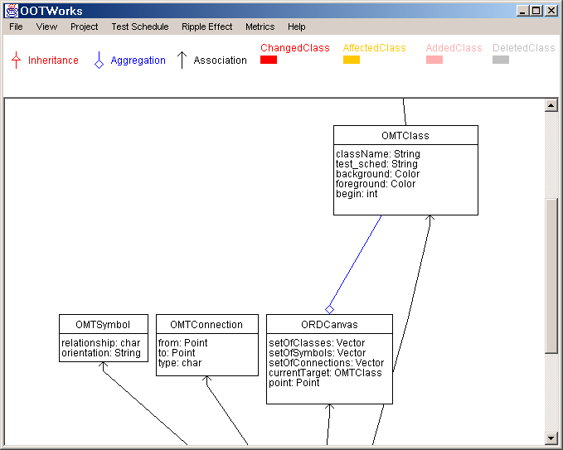

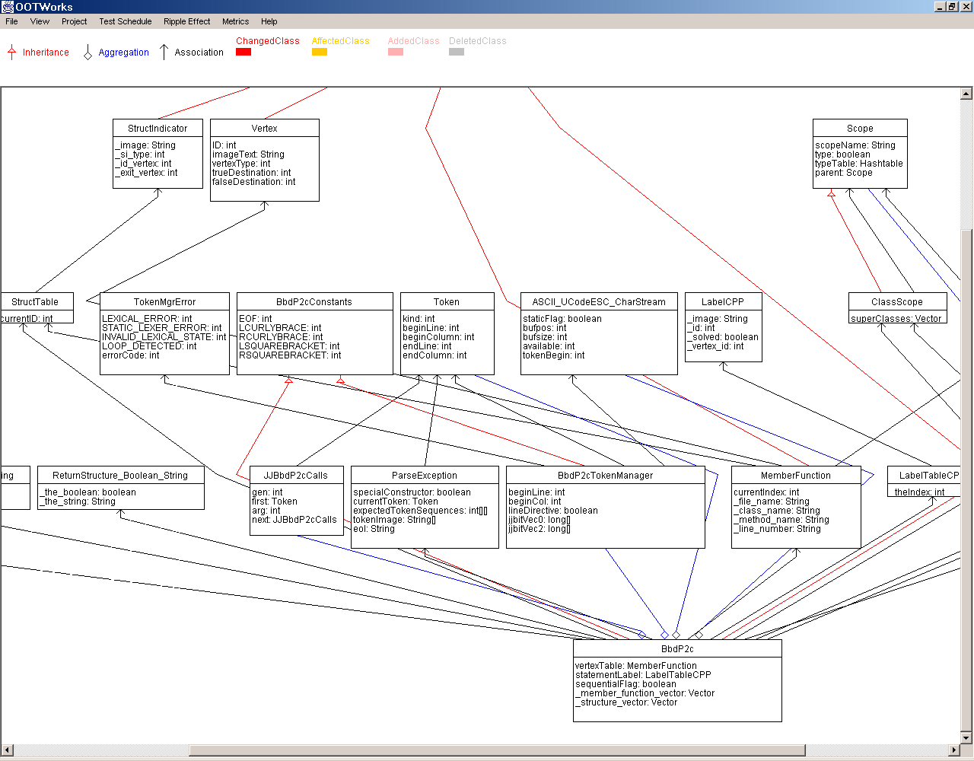
Tip for Domain Modeling
Do not do brainstorming and drawing at the same time. The result could be very poor.
1) Team brainstorming: List the concepts, and then classify them on a whiteboard.
2) Take a picture(s) of the whiteboard using a digital camera.
3) Email the digital images to team members.
5) Email the UML class diagram to all members to review.
4) Have a member or two to convert the result to a UML class diagram.
6) Modify the diagram to reflect corrections and comments.
5-<number>

Slide 19
Applying Agile Principles
Work closely with the customer and users to understand their application and application domain.
Perform domain modeling only if it is needed. Keep it simple and expand it incrementally.
Domain modeling may be performed simultaneously with actor-system interaction modeling, object interaction modeling, object state modeling, and activity modeling.
5-<number>

Slide 20
Example: POS checkout
Main Success Scenario (cash only):
Customer arrives at POS checkout with goods and/or services to purchases
Cashier starts new sale
Cashier enters item identifier
System records sale line item and presents item description, price, and running total
(repeat 2-3 until no more items)
5-<number>

Slide 21
Example: POS checkout
Main Success Scenario (cash only):
Customer arrives at POS checkout with goods and/or services to purchases
Cashier starts new sale
Cashier enters item identifier
System records sale line item and presents item description, price, and running total
(repeat 2-3 until no more items)
5-<number>

Slide 22
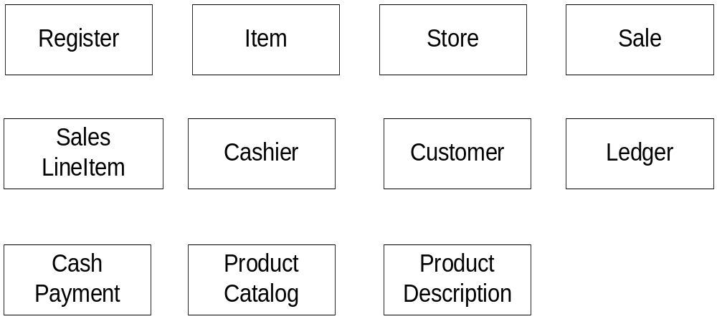
Example – Initial Draft of Domain Model for POS
5-<number>

Slide 23
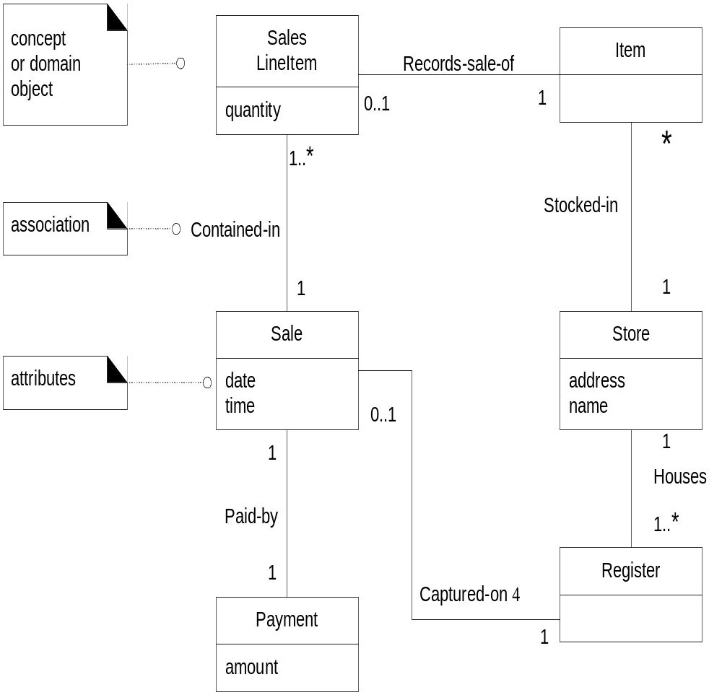
This diagram shows an example of a an early Domain Model for the POS system.
5-<number>

Slide 24
Class Exercise
Do the following for the vending machine (next slide).
Identify the concepts that exist in the application domain.
Classify the concepts in terms of
  classes
  attributes of classes
  relationships between the classes
    inheritance
    aggregation and
    association
5-<number>

Slide 25
Class Exercise: The Vending Machine
The Vending Machine has a display, an alphanumeric keypad, a coin insertion slot, and an item dispenser. The display shows the vending items like chocolates, candies, potato chips, Coke, sprite, etc. Each type of item has a price and a label consisting of a letter A, B, C, ... and a digit 1, 2, ... A customer inserts coins through the coin slot. Each time a coin is inserted an LCD displays the total amount. The customer can press a letter and a digit to enter his selection after enough coins have been inserted. If the total amount is greater than or equals to the item selected, the vending machine dispenses the item and returns the change to the customer. A customer can change his mind and request that the coins be returned by pressing the return button.
5-<number>

Slide 26
Class Exercise: The Vending Machine
The Vending Machine has a display, an alphanumeric keypad, a coin insertion slot, and an item dispenser. The display shows the vending items like chocolates, candies, potato chips, Coke, sprite, etc. Each type of item has a price and a label consisting of a letter A, B, C, ... and a digit 1, 2, ... A customer inserts coins through the coin slot. Each time a coin is inserted an LCD displays the total amount. The customer can press a letter and a digit to enter his selection after enough coins have been inserted. If the total amount is greater than or equals to the item selected, the vending machine dispenses the item and returns the change to the customer. A customer can change his mind and request that the coins be returned by pressing the return button.
5-<number>

